Slide 1
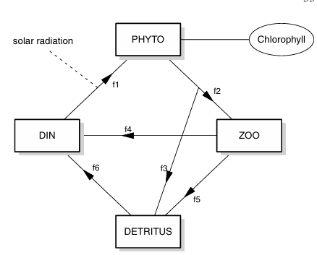
Agricultural run-off
f7
Stream draining lake
f8

